Slide 1





Consumer Goods Ad_Hoc Insights Atliq Hardware
Built for performance, built for India, built for the world

Slide 2

Table of contents
01
02
03
04
Problem Statement
Objective
Problem Statement by the stakeholders
List of tasks to be completed
Analysis
Insights
Analysis of the dataset
Key takeaways from the analysis

Slide 3
About us
Atliq Hardwares (imaginary company) is one of the leading computer hardware producers in India and well expanded in other countries too.

Slide 4
Objectives
1. Provide the list of markets in which customer "Atliq Exclusive" operates its business in the APAC region.
2. What is the percentage of unique product increase in 2021 vs. 2020?
3. Provide a report with all the unique product counts for each segment and sort them in descending order of product counts.
4. Follow-up: Which segment had the most increase in unique products in 2021 vs 2020?
5. Get the products that have the highest and lowest manufacturing costs.
6. Generate a report which contains the top 5 customers who received an average high pre_invoice_discount_pct for the fiscal year 2021 and in the Indian market.
7. Get the complete report of the Gross sales amount for the customer “Atliq Exclusive” for each month. This analysis helps to get an idea of low and high-performing months and take strategic decisions.
8. In which quarter of 2020, got the maximum total_sold_quantity?
9. Which channel helped to bring more gross sales in the fiscal year 2021 and the percentage of contribution?
10. Get the Top 3 products in each division that have a high total_sold_quantity in the fiscal_year 2021?

Slide 5

Problem
How to analyze the tasks?

Slide 6
Solution
It’s simple! We could use SQL.

Slide 7


Our team
Tony Sharma
Abhishek Shettigar
Data Analytics Director
Data Analyst

Slide 8
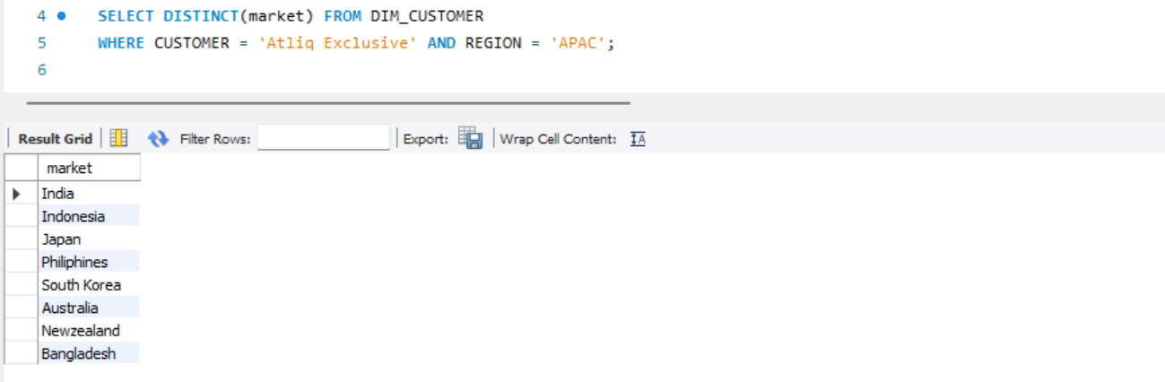
Request 1
Query and Results
Provide the list of markets in which customer "Atliq Exclusive" operates its business in the APAC region.
Atliq Exclusive operates in several markets within the APAC region. Understanding their geographical reach provides insights into customer base and potential expansion opportunities.

Slide 9
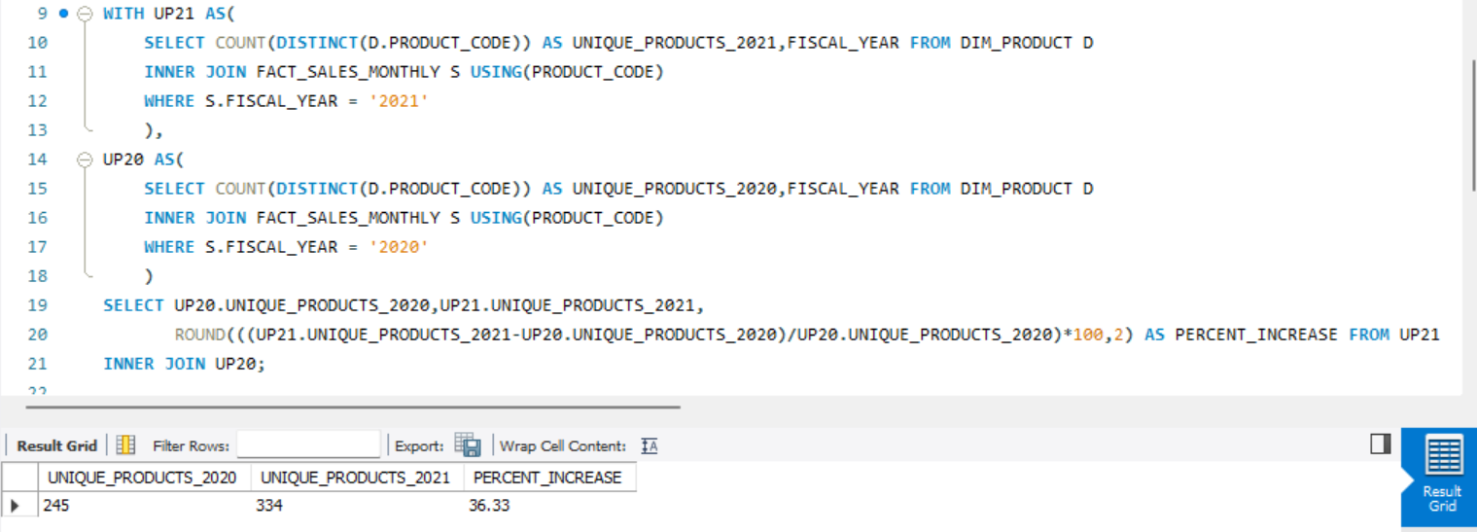
Request 2
Query and Results
What is the percentage of unique product increase in 2021 vs. 2020?
Percentage increase in unique products between 2020 and 2021 reveals product diversification and growth strategies.

Slide 10
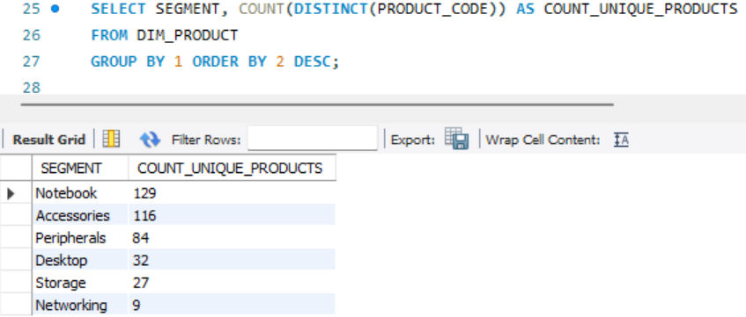
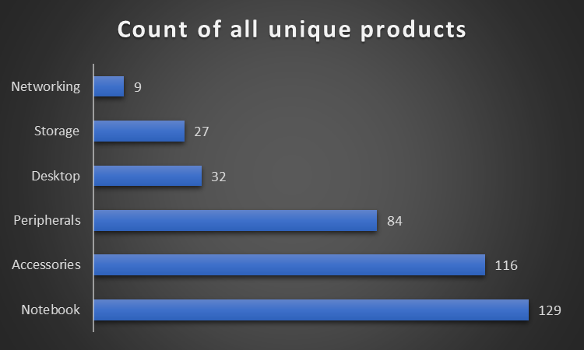
Request 3
Query and Results
Visuals
Provide a report with all the unique product counts for each segment and sort them in descending order of product counts.

Slide 11
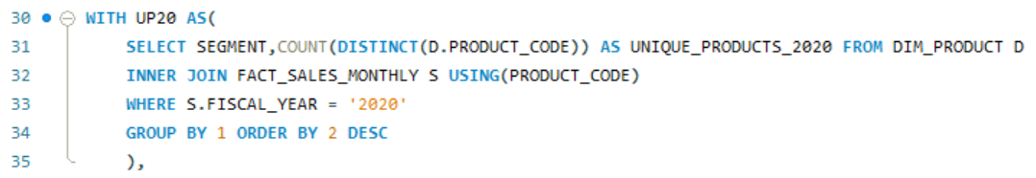
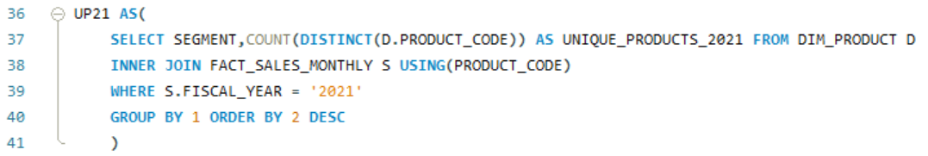
Request 4
Query
Follow-up: Which segment had the most increase in unique products in 2021 vs 2020?

Slide 12

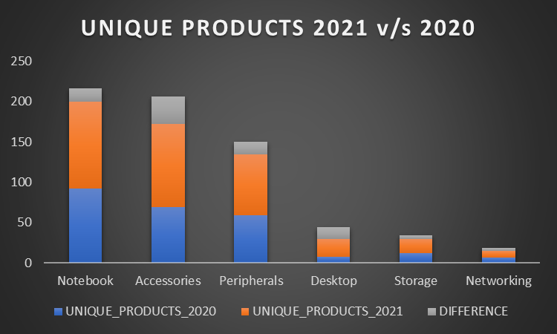
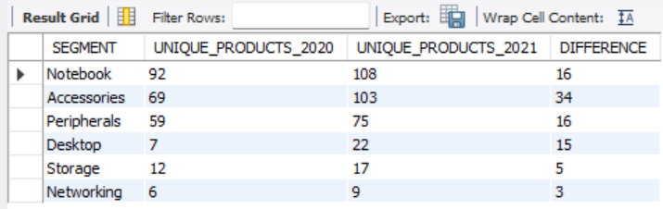
Query continues…
Results
Visuals
Identifying segments with high unique product counts and tracking their growth helps prioritize marketing and development efforts.

Slide 13
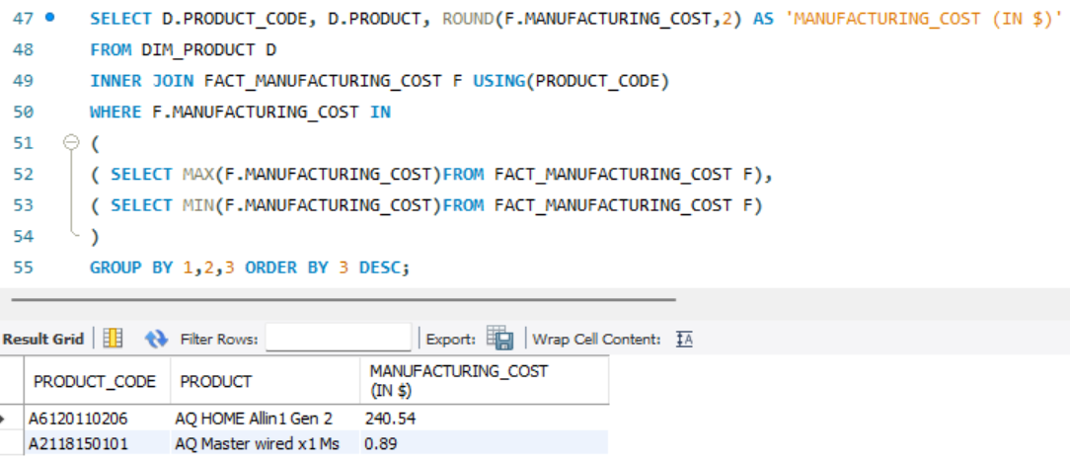
Request 5
Query and Results
Get the products that have the highest and lowest manufacturing costs.
Analyzing products with high and low manufacturing costs guides cost-reduction strategies and product portfolio optimization.

Slide 14
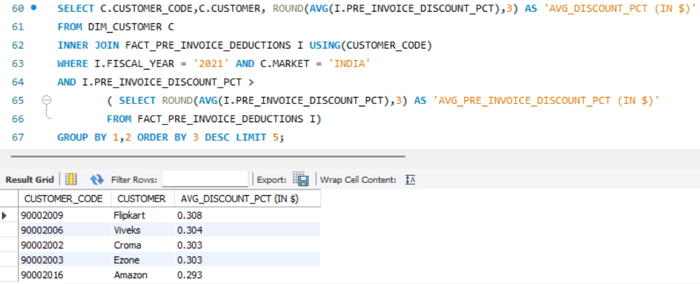

Request 6
Query and Results
Generate a report which contains the top 5 customers who received an average high pre_invoice_discount_pct for the fiscal year 2021 and in the Indian market.
Identifying top customers based on average pre-invoice discount reveals valuable customer segments and potential for further discounts or loyalty programs.

Slide 15
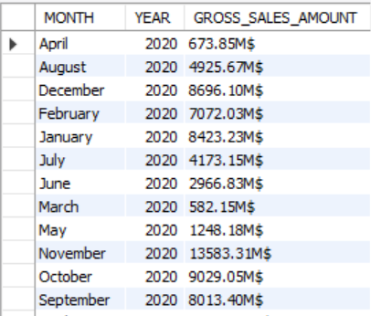
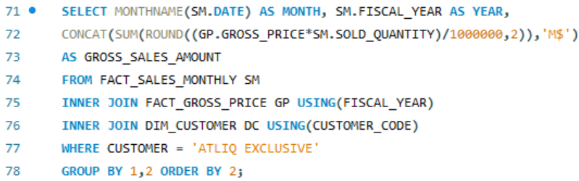
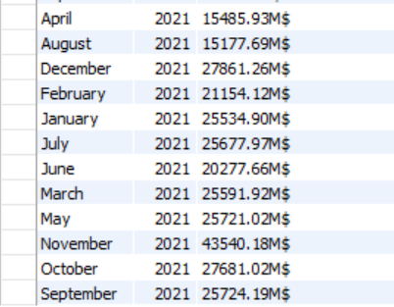
Request 7
Query and Results
Get the complete report of the Gross sales amount for the customer “Atliq Exclusive” for each month. This analysis helps to get an idea of low and high-performing months and take strategic decisions.
Gross sales report for Atliq Exclusive helps identify high-performing and low-performing months for strategic planning and resource allocation.

Slide 16
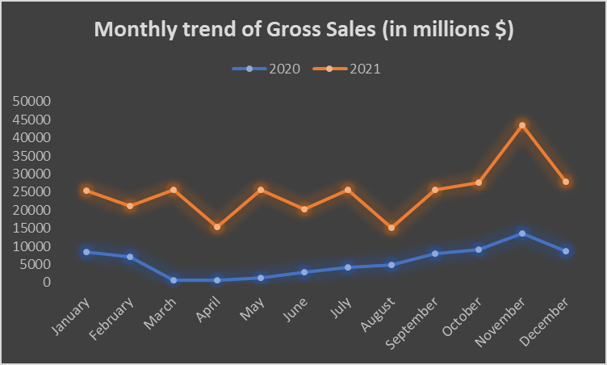
Visuals
Gross sales report for Atliq Exclusive helps identify high-performing and low-performing months for strategic planning and resource allocation.

Slide 17
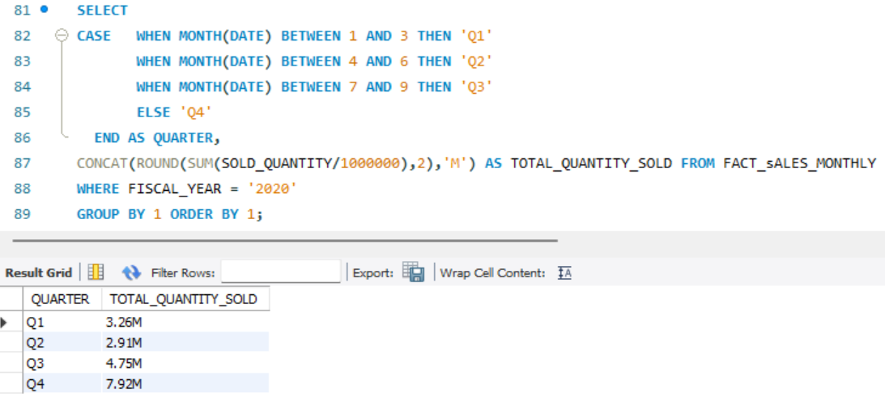
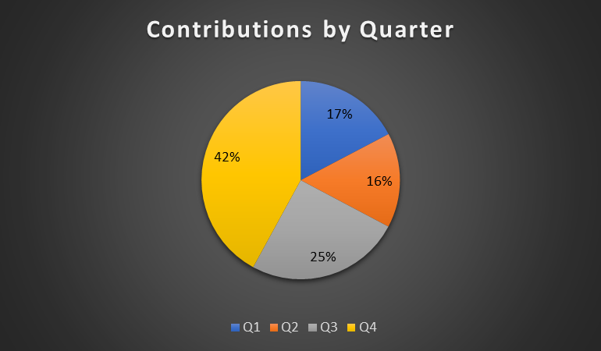
Request 8
Query and Results
Visuals
In which quarter of 2020, got the maximum total_sold_quantity?
Determining the quarter with the highest total sold quantity in 2020 and the channel with the highest gross sales contribution in 2021 provides valuable insights into seasonal trends and effective sales channels.

Slide 18
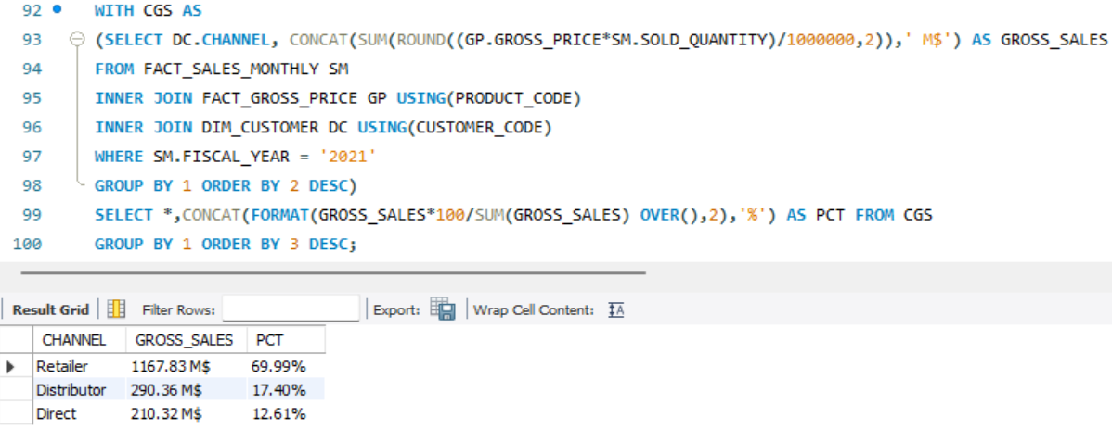
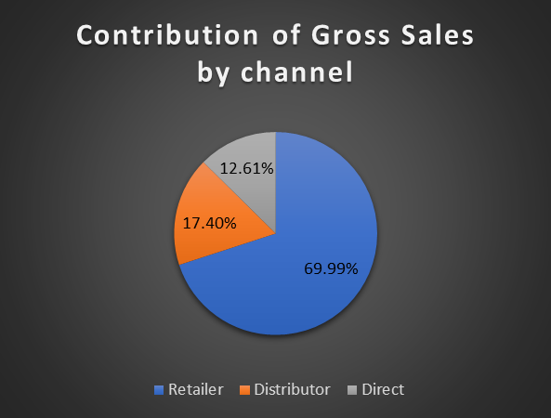
Request 9
Query and Results
Visuals
Which channel helped to bring more gross sales in the fiscal year 2021 and the percentage of contribution?

Slide 19
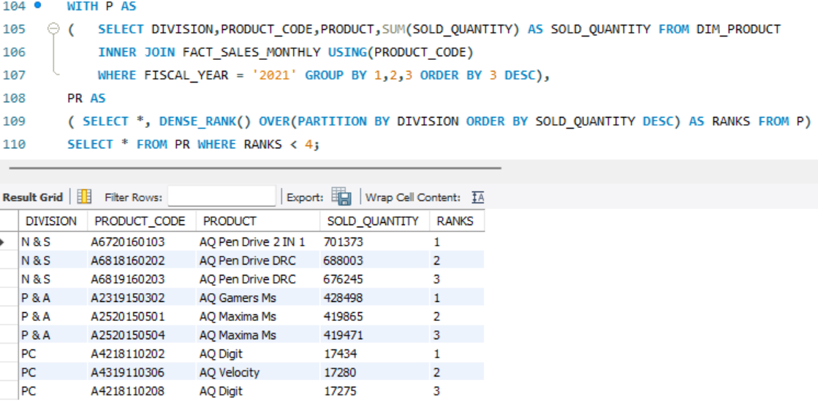
Request 10
Query and Results
Get the Top 3 products in each division that have a high total_sold_quantity in the fiscal_year 2021?

Slide 20
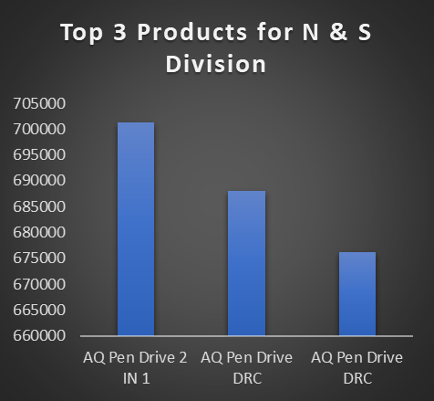
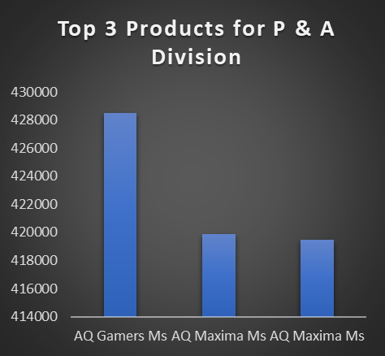
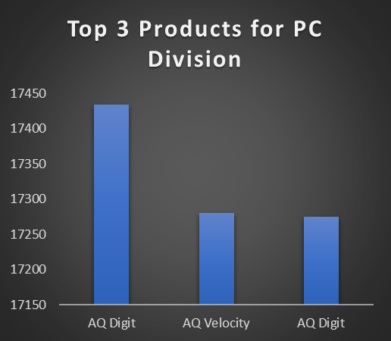
Visuals
Identifying the top 3 products in each division based on total sold quantity in 2021 helps prioritize production, marketing, and sales efforts for these high-performing products.

Slide 21
Thanks for Attending!
LinkedIn profile:- Abhishek Ramesh Shettigar
Medium profile:-Abhishek Ramesh Shettigar
Data Analyst Portfolio:- Abhishek Ramesh Shettigar
Email:- shettigaraabhishek@gmail.com
Github:- AbhishekDataAnalyst

